Slide 1
Google Cloud Platform Fundamentals
Notes:
Author: Ahmed Hosni
1

Slide 2
Agenda
1- Introduction to Google Cloud Platform
2- Compute
3- Storage
4- Networking
5- Building for “Cloud 3.0”
6- Machine Learning
7- Virtual Private Cloud (VPC) Network
8- Compute Engine
9- Compute Engine
10- Important VPC capabilities
11- Google Cloud Platform resource hierarchy
12- Identity and Access Management (IAM)
13- Interacting with Google Cloud Platform
14- Google Kubernetes Engine (GKE)
2

Slide 3
Introduction to Google Cloud Platform
Notes:
Author: Ahmed Hosni
3

Slide 4
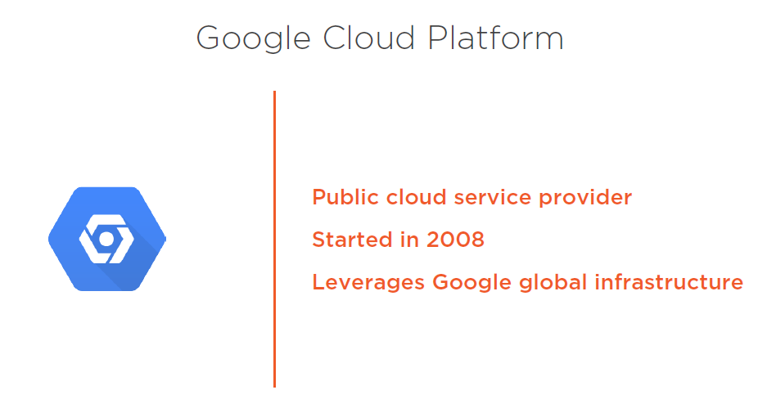

Slide 5
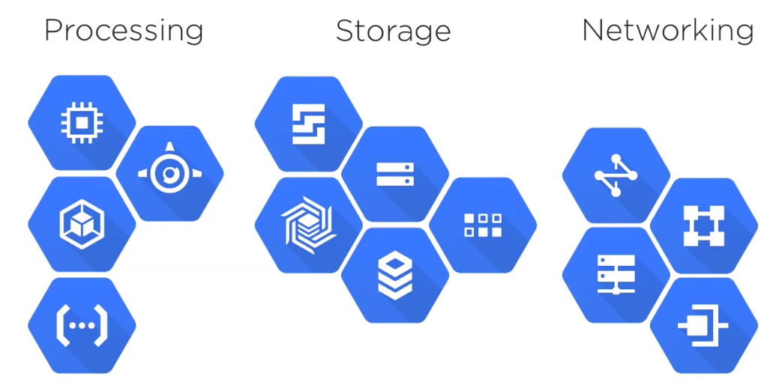
5

Slide 6
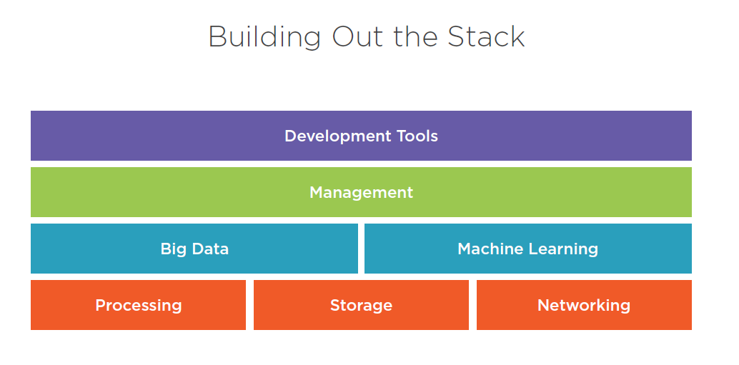

Slide 7
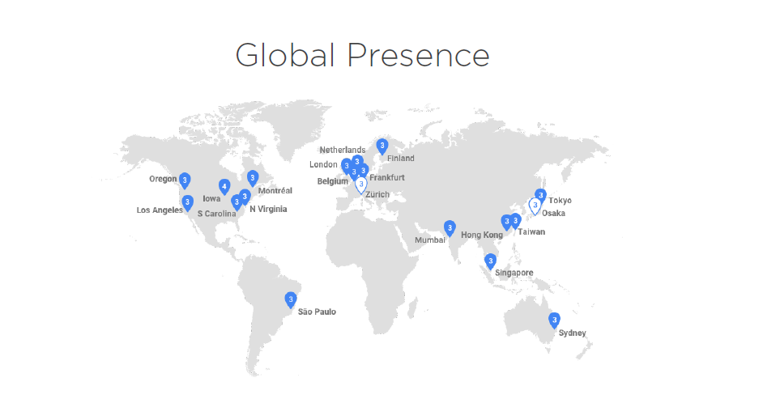

Slide 8
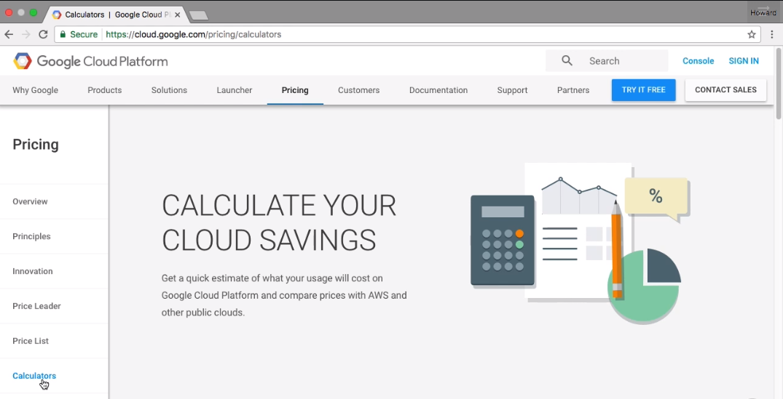

Slide 9
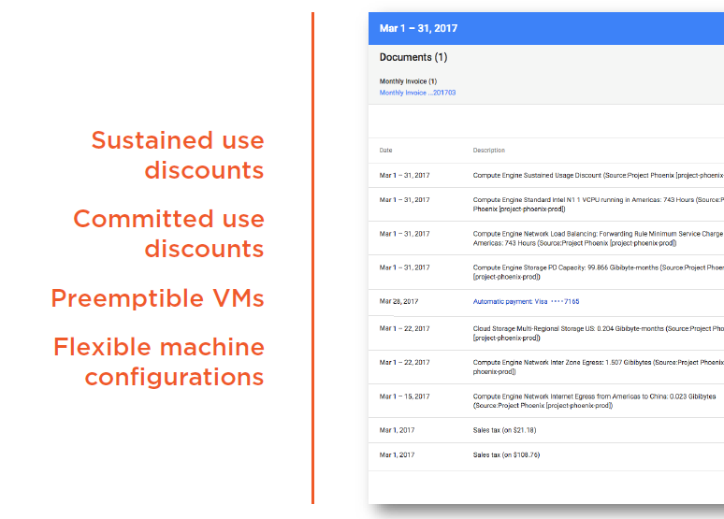

Slide 10
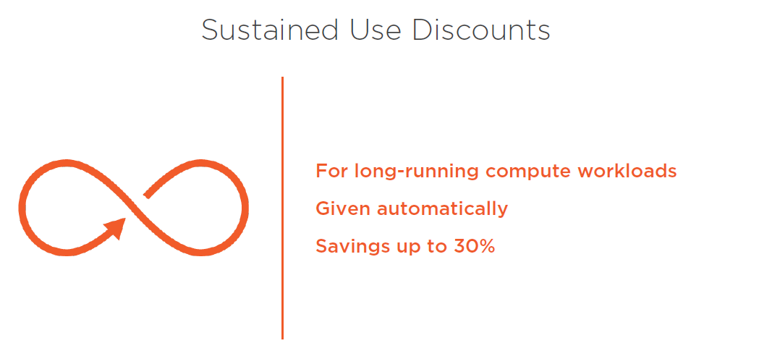

Slide 11
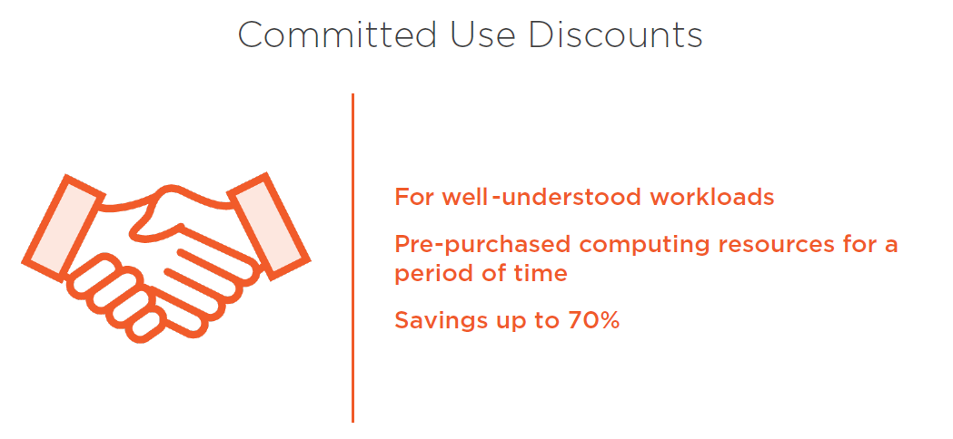

Slide 12
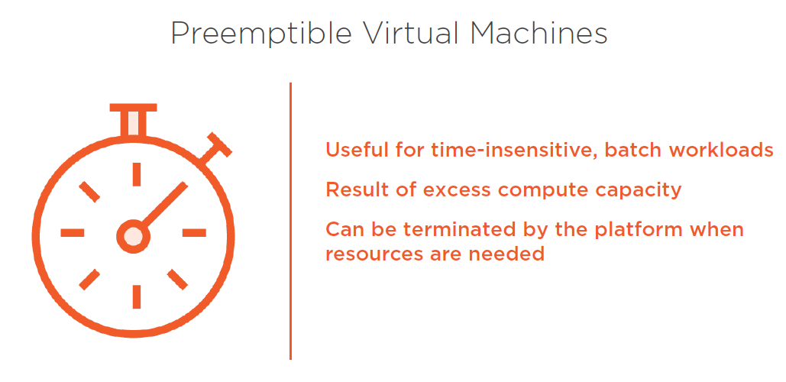

Slide 13
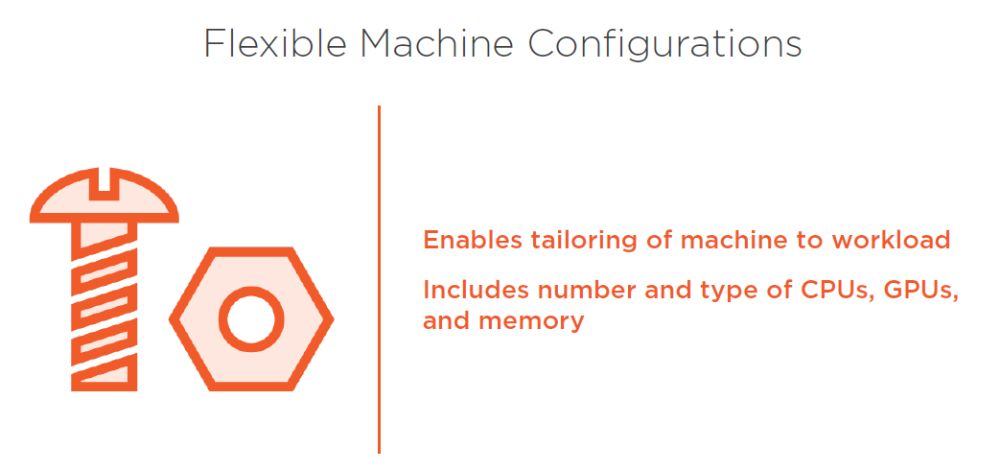

Slide 14
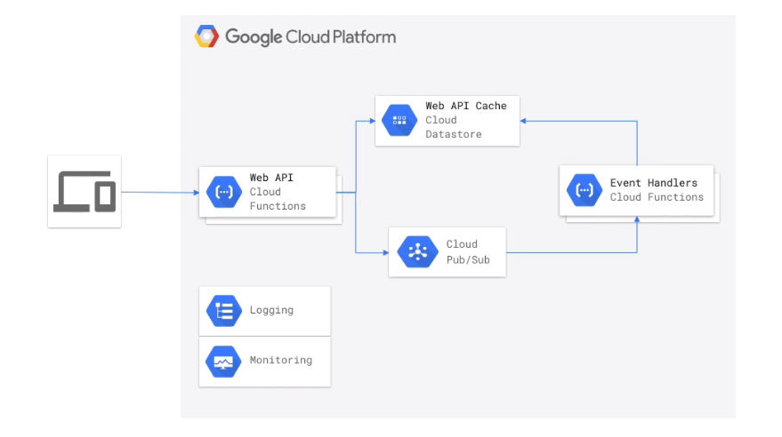

Slide 15
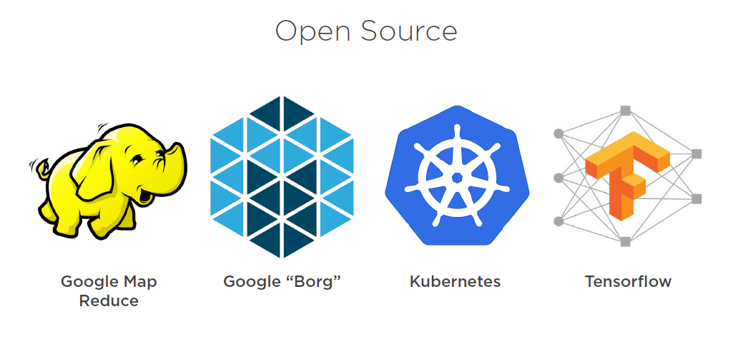

Slide 16

Compute services

Slide 17
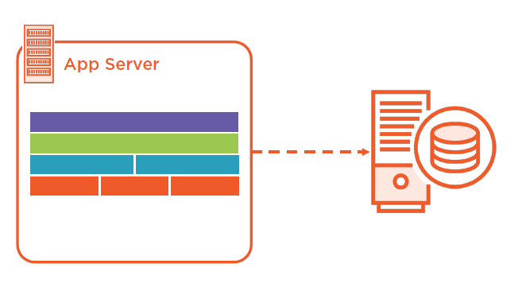
From IaaS to PaaS

Slide 18
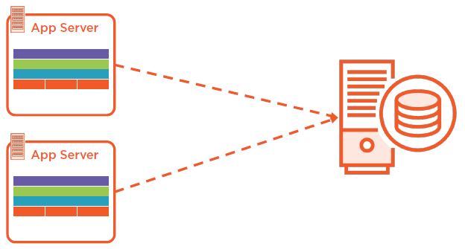
From IaaS to PaaS

Slide 19
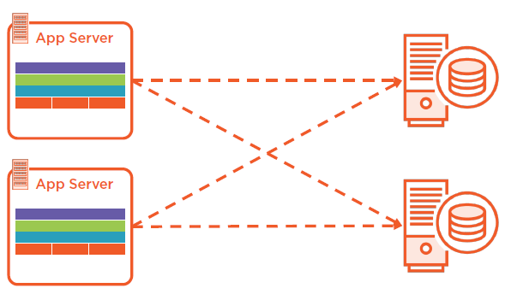
From IaaS to PaaS

Slide 20
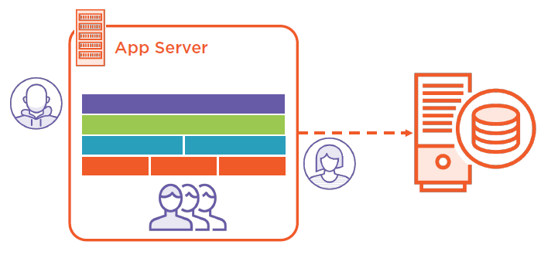
From IaaS to PaaS

Slide 21
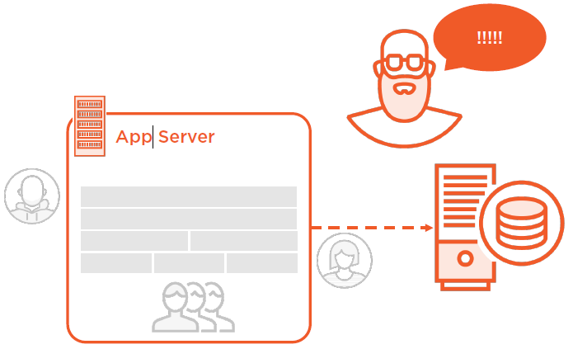

Slide 22
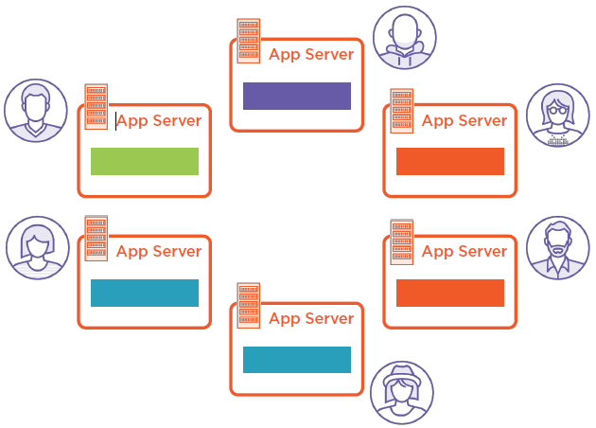

Slide 23
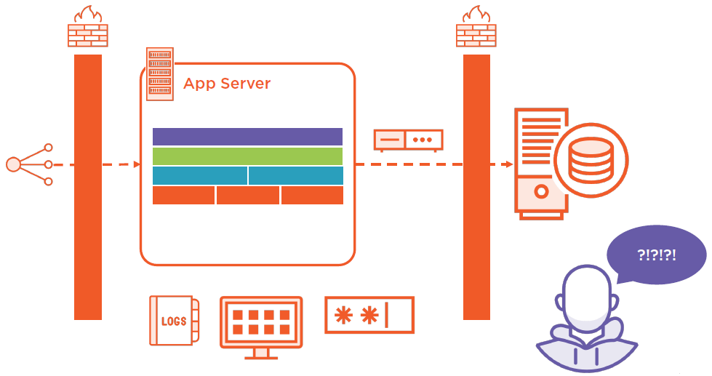
Notes:
“Nanoserviceis an antipatternwhere a service is too fine-grained. A nanoserviceis a service whose overhead outweighs its utility.”

Slide 24
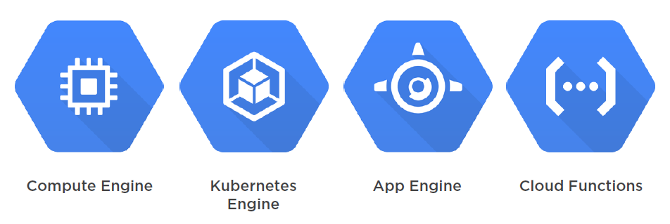
Compute Services

Slide 25
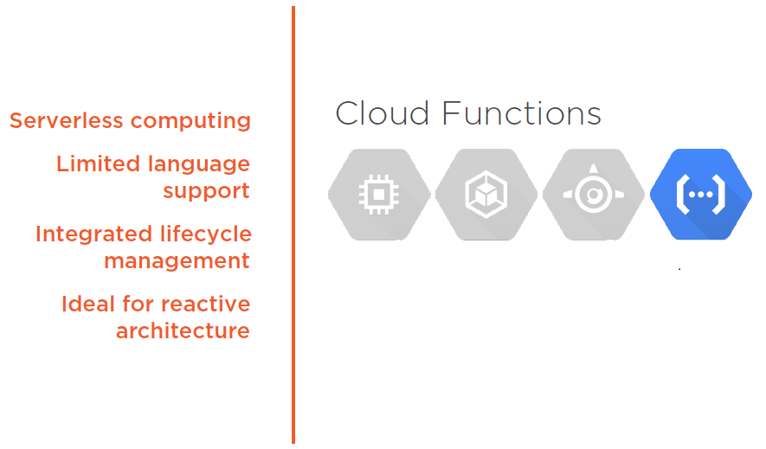

Slide 26
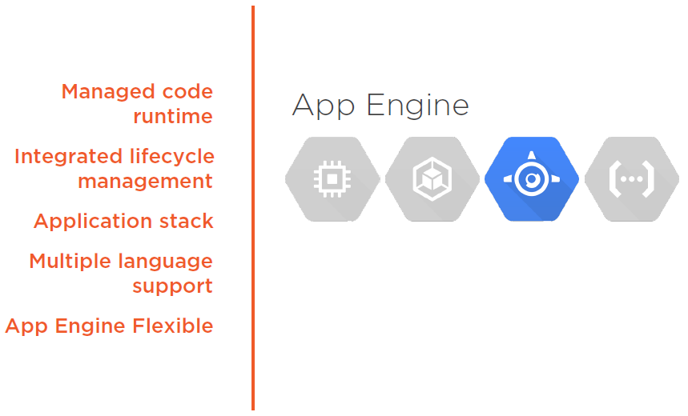

Slide 27
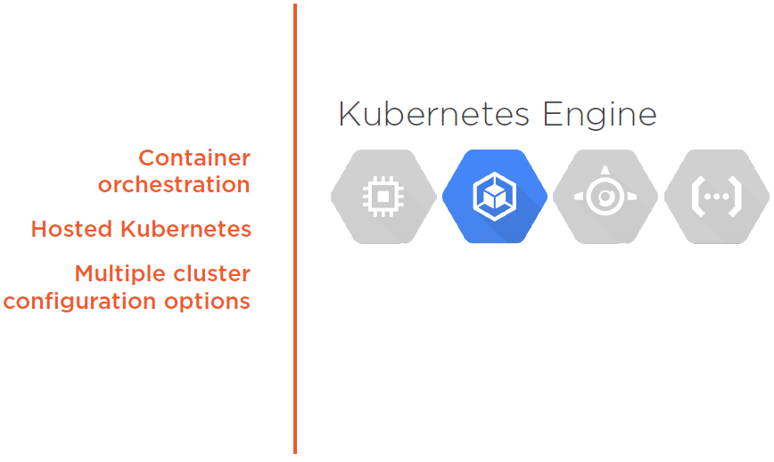

Slide 28
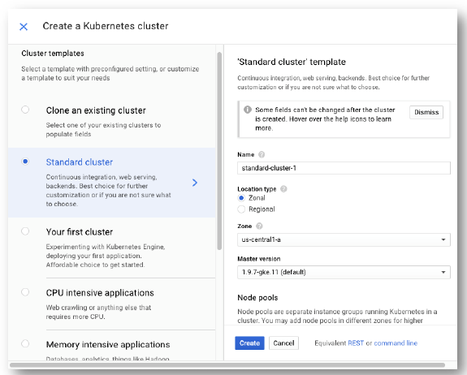
Cluster Templates

Slide 29
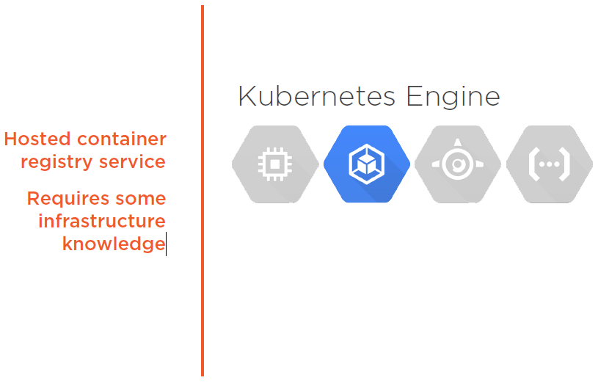

Slide 30
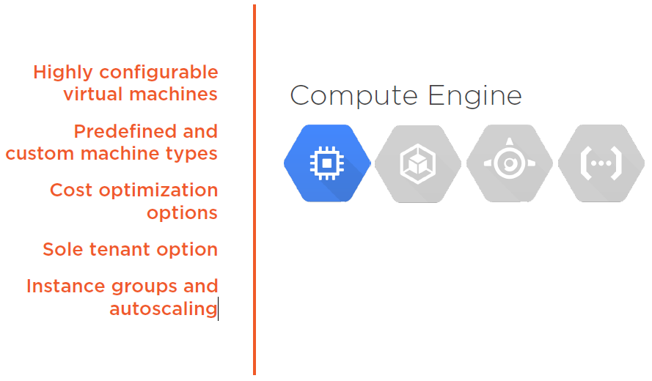

Slide 31
Storage services

Slide 32
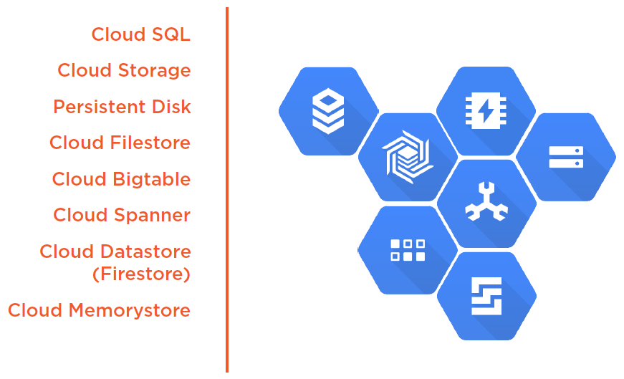

Slide 33
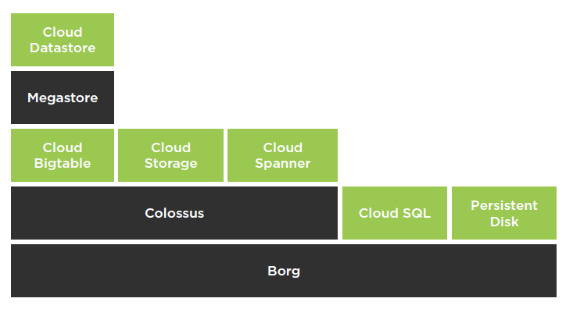
Technology Layering

Slide 34
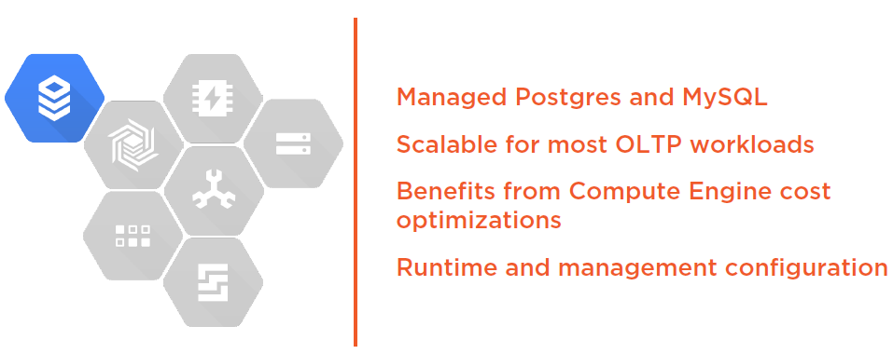
Cloud SQL

Slide 35
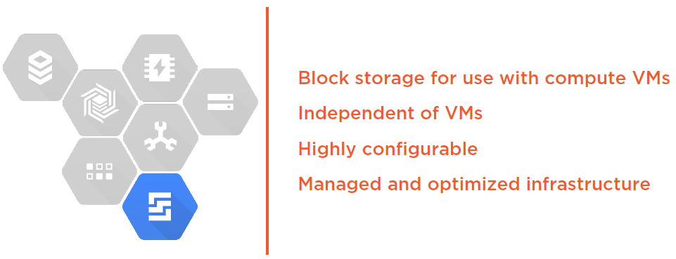
Persistent Disks

Slide 36
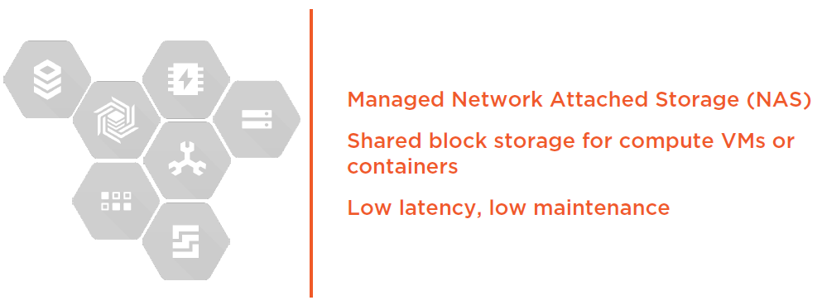
Cloud Filestore

Slide 37
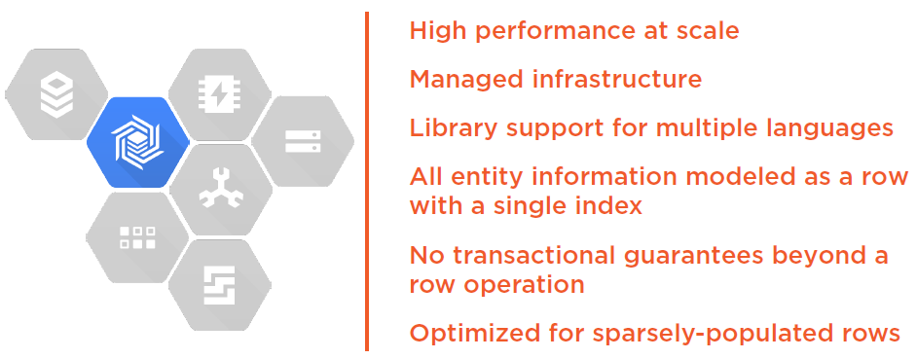
Cloud Bigtable

Slide 38
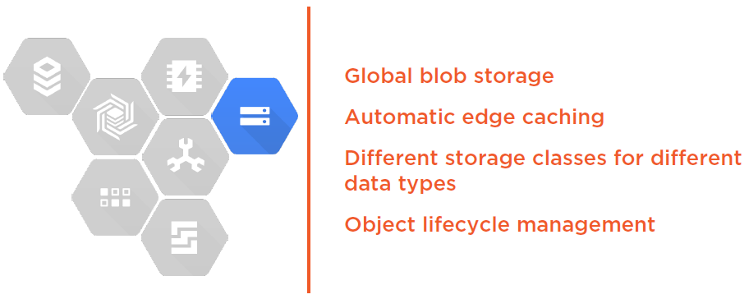
Cloud Storage

Slide 39
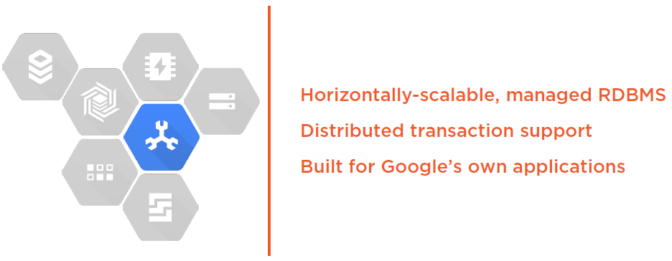
Cloud Spanner
Notes:
https://goo.gl/wKy25P

Slide 40
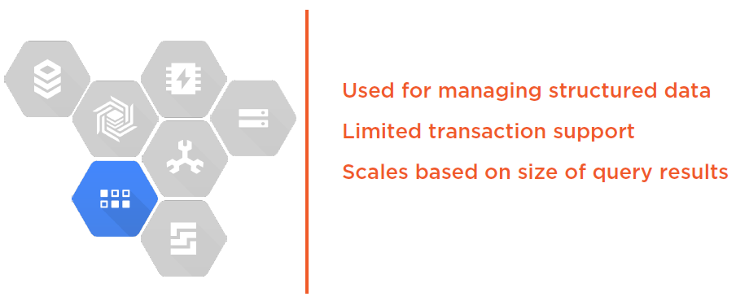
Cloud Datastore

Slide 41
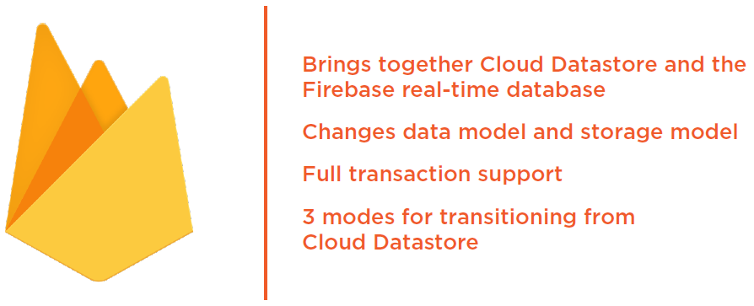
Cloud Firestore

Slide 42
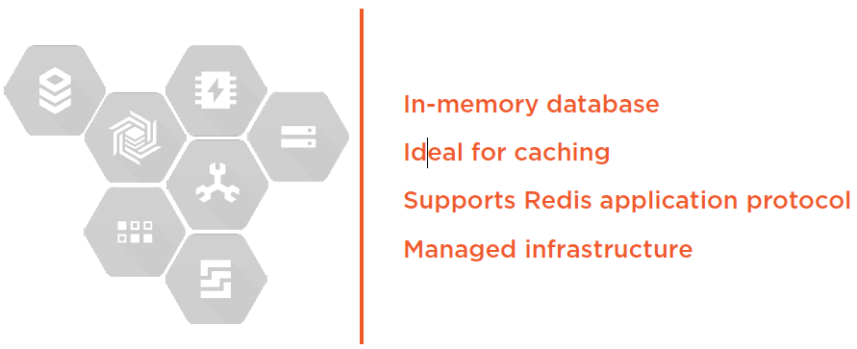
Cloud Memorystore

Slide 43
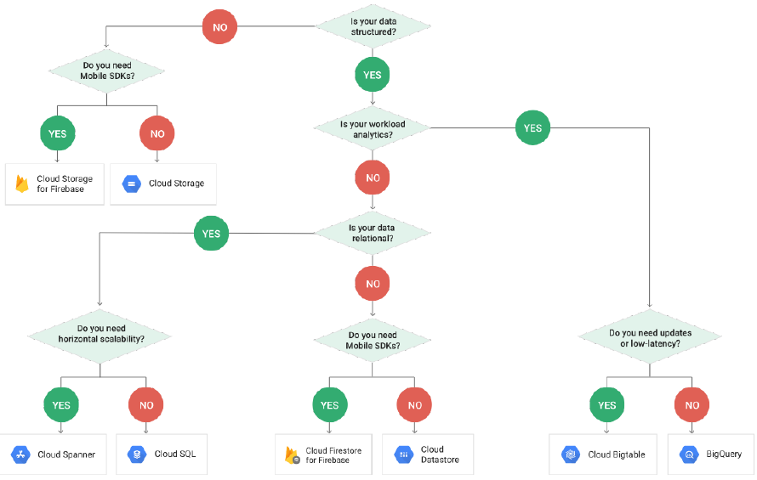

Slide 44
Networking services

Slide 45
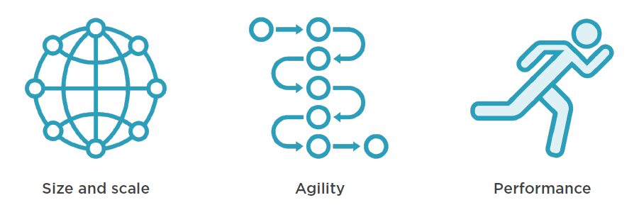
What Makes Google’s Network Special?

Slide 46
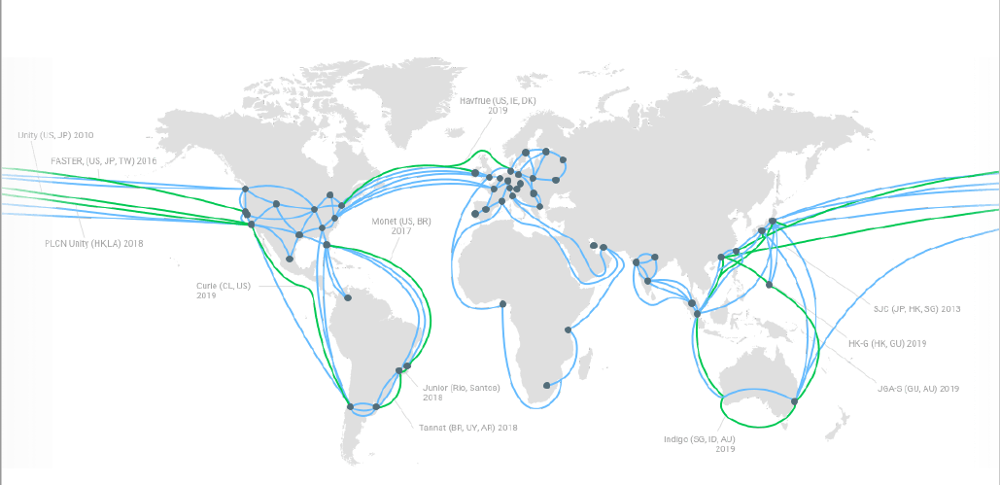

Slide 47
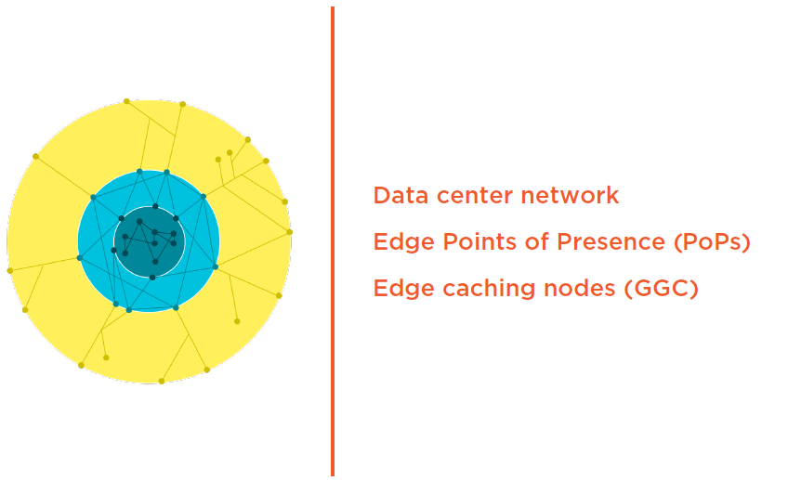

Slide 48
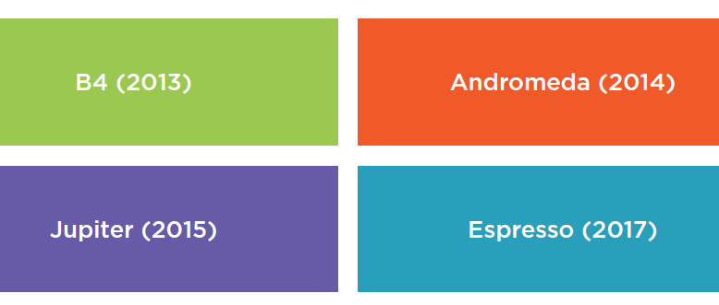
Software Defined Networking (SDN)

Slide 49
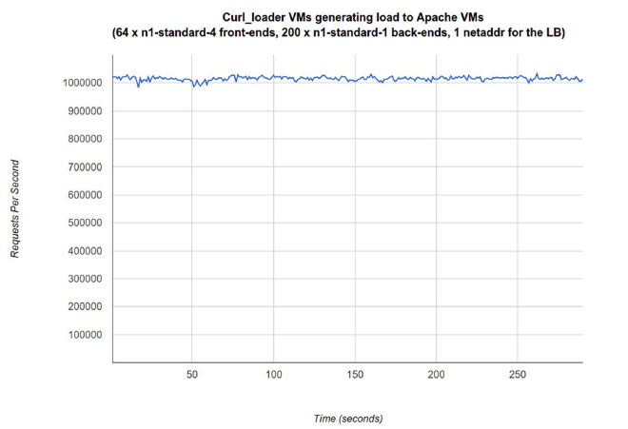
Performance

Slide 50
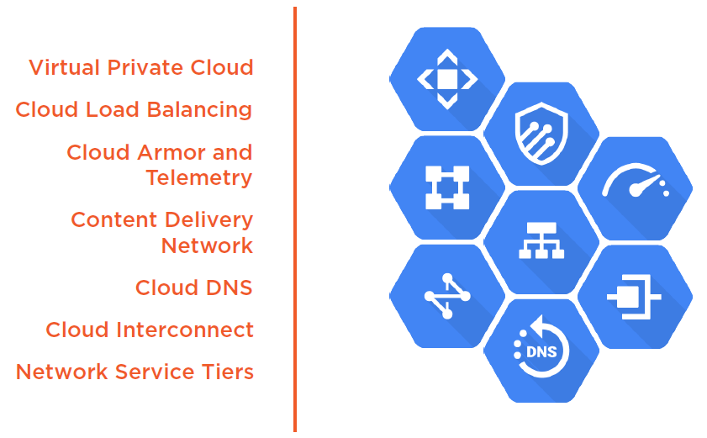

Slide 51
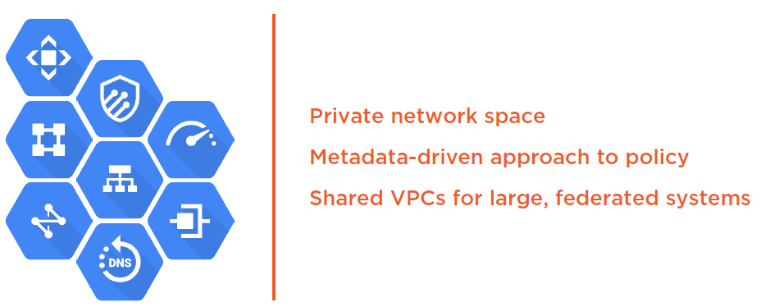
Virtual Private Cloud (VPC)

Slide 52
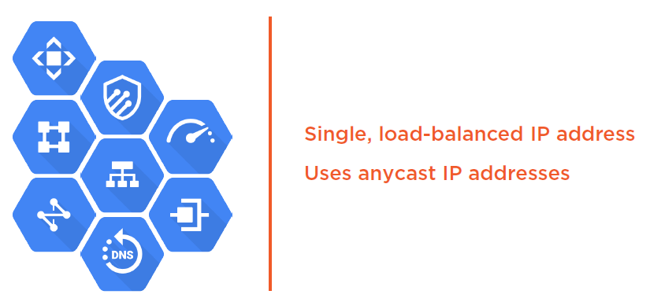
Cloud Load Balancing

Slide 53
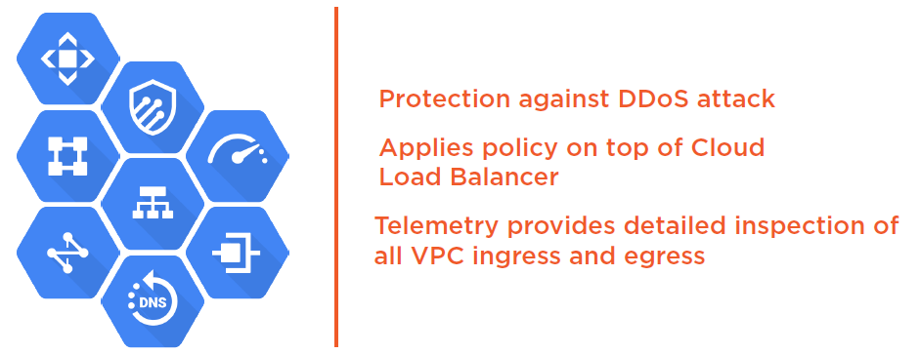
Cloud Armor and Telemetry

Slide 54
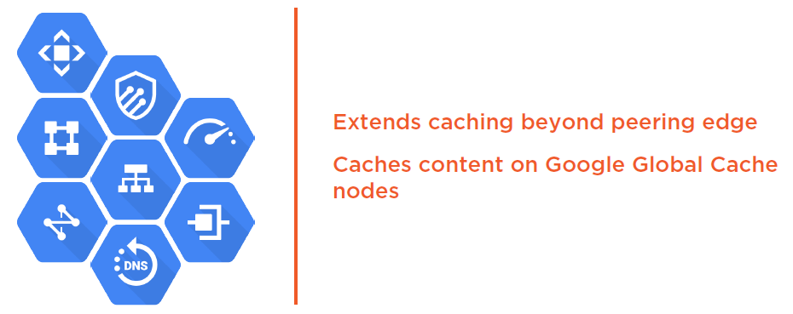
Content Delivery Network (CDN)

Slide 55
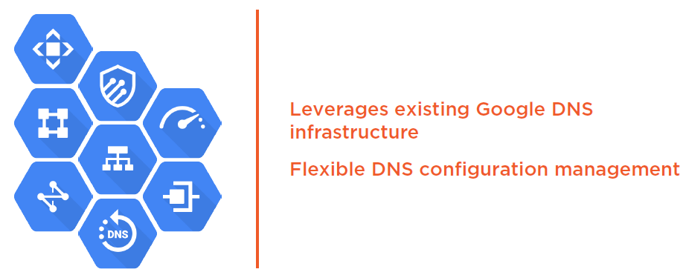
Cloud DNS

Slide 56
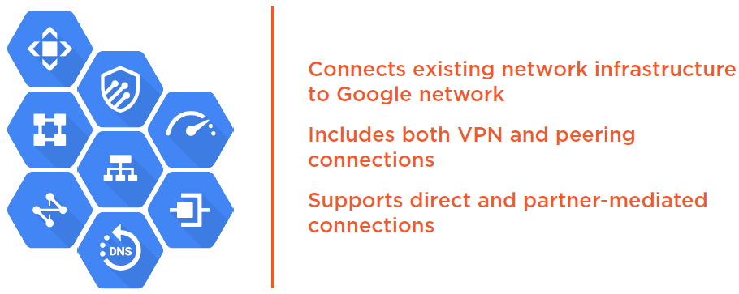
Cloud Interconnect

Slide 57

Network Service Tiers

Slide 58

Enabling “Cloud 3.0”

Slide 59


Slide 60
Building for “Cloud 3.0”

Slide 61


Slide 62


Slide 63


Slide 64


Slide 65


Slide 66


Slide 67


Slide 68


Slide 69


Slide 70


Slide 71


Slide 72


Slide 73


Slide 74


Slide 75


Slide 76


Slide 77


Slide 78


Slide 79



Slide 80


Slide 81
Machine Learning

Slide 82


Slide 83


Slide 84


Slide 85
Virtual Private Cloud (VPC) Network
Notes:
Author: Ahmed Hosni
85

Slide 86

86

Slide 87
Your VPC networks connect your Google Cloud Platform resources to each other and to the internet.
You can segment your networks, use firewall rules to restrict access to instances, and create static routes to forward traffic to specific destinations.
Many users get started with GCP by defining their own Virtual Private Cloud inside their first GCP project.
Or they can simply choose the default VPC and get started with that.
87

Slide 88
Google Virtual Private Cloud networks that you define have global scope.
They can have subnets in any GCP region worldwide.
Subnets can span the zones that make up a region.
This architecture makes it easy for you to define your own network layout with global scope.
You can also have resources in different zones on the same subnet.
88

Slide 89

89

Slide 90
You can dynamically increase the size of a subnet in a custom network by expanding the range of IP addresses allocated to it.
Doing that doesn’t affect already configured VMs.
In this example, your VPC has one network. So far, it has one subnet defined, in GCP’s us-east1 region.
Notice that it has two Compute Engine VMs attached to it.
They’re neighbors on the same subnet even though they are in different zones!
You can use this capability to build solutions that are resilient but still have simple network layouts.
90

Slide 91
Compute Engine
Notes:
Author: Ahmed Hosni
91

Slide 92

92

Slide 93
Virtual machines have the power and generality of a full-fledged operating system in each.
You configure a virtual machine much like you build out a physical server:
=> By specifying its amounts of CPU power and memory, its
amounts and types of storage, and its operating system.
Compute Engine lets you create and run virtual machines on Google infrastructure.
There are no upfront investments, and you can run thousands of virtual CPUs on a system that is designed to be fast and to offer consistent performance.
93

Slide 94

94

Slide 95
You can create a virtual machine instance by using the Google Cloud Platform Console or the gcloud command-line tool.
A Compute Engine can run Linux and Windows Server images provided by Google or any instance customized versions of these images.
You can also build and run images of other operating systems.
95

Slide 96

96

Slide 97
Important VPC capabilities

Slide 98

98

Slide 99

99

Slide 100

100

Slide 101

101

Slide 102

102

Slide 103

103

Slide 104
Google Cloud Platform resource hierarchy

Slide 105

105

Slide 106

106

Slide 107

107

Slide 108

108

Slide 109

109

Slide 110

110

Slide 111

111

Slide 112

112

Slide 113
Identity and Access Management (IAM)

Slide 114

114

Slide 115

115

Slide 116

116
Notes:
The “can do what” part is defined by an IAM role. An IAM role is a collection of
permissions. Most of the time, to do any meaningful operations, you need more than
1 permission. For example, to manage instances in a project, you need to create,
delete, start, stop and change an instance. So the permissions are grouped together
into a role to make them easier to manage.

Slide 117

117
Notes:
When you give a user, group, or service account a role on a specific element of the
resource hierarchy, the resulting policy applies to the element you chose, as well as
to elements below it in the hierarchy.

Slide 118

118

Slide 119

119

Slide 120

120

Slide 121

121

Slide 122

122

Slide 123

123

Slide 124

124

Slide 125

125

Slide 126

126

Slide 127
Interacting with Google Cloud Platform

Slide 128

128

Slide 129

129

Slide 130

130

Slide 131

131

Slide 132

132
Notes:
https://developers.google.com/apis-explorer/

Slide 133

133
Notes:
https://cloud.google.com/sdk/cloud-client-libraries
https://developers.google.com/api-client-library

Slide 134
Google Kubernetes Engine (GKE)
Notes:
Author: Ahmed Hosni
134

Slide 135
Introducing Containers
Notes:
Author: Ahmed Hosni
135

Slide 136

136

Slide 137

137

Slide 138

138

Slide 139

139

Slide 140

140

Slide 141

141

Slide 142

142

Slide 143

143

Slide 144

144

Slide 145

145

Slide 146

146

Slide 147

147

Slide 148

148

Slide 149

149

Slide 150

150

Slide 151
Introducing Kubernetes
Notes:
Author: Ahmed Hosni
151

Slide 152

152

Slide 153

153

Slide 154

154

Slide 155

155

Slide 156

156

Slide 157

157

Slide 158

158

Slide 159

159

Slide 160

160

Slide 161

161

Slide 162

162

Slide 163

163

Slide 164

164
Notes:
All of these are possible in a Kubernetes cluster using higher-level abstractions

Slide 165

165

Slide 166

166

Slide 167

167

Slide 168

168

Slide 169

169

Slide 170

170

Slide 171

171

Slide 172

172

Slide 173

173

Slide 174

174

Slide 175

175

Slide 176
Introducing Google Kubernetes Engine
Notes:
Author: Ahmed Hosni
176

Slide 177

177

Slide 178

178

Slide 179

179

Slide 180

180

Slide 181

181

Slide 182

182

Slide 183

183

Slide 184

184

Slide 185

185

Slide 186

186

Slide 187
Lab: Creating a GKE Cluster

Slide 188
Forget Containers, Meet Pods!
Notes:
Author: Ahmed Hosni
188

Slide 189

189

Slide 190

190

Slide 191

191

Slide 192

192

Slide 193

193

Slide 194

194

Slide 195

195

Slide 196

196

Slide 197

197

Slide 198

198

Slide 199

199

Slide 200

200

Slide 201
The Anatomy of a Cluster
Notes:
Author: Ahmed Hosni
201

Slide 202

202

Slide 203

203

Slide 204

204

Slide 205

205

Slide 206

206

Slide 207

207

Slide 208

208

Slide 209
ReplicaSets and Deployments
Notes:
Author: Ahmed Hosni
209

Slide 210

210

Slide 211

211

Slide 212

212

Slide 213

213

Slide 214

214

Slide 215

215

Slide 216

216

Slide 217

217

Slide 218

218

Slide 219

219

Slide 220

220

Slide 221

221

Slide 222
Accessing Applications
Notes:
Author: Ahmed Hosni
222

Slide 223

223

Slide 224

224

Slide 225

225

Slide 226

226

Slide 227

227

Slide 228
Volume Abstractions
Notes:
Author: Ahmed Hosni
228

Slide 229

229

Slide 230

230

Slide 231

231

Slide 232

232

Slide 233

233

Slide 234

234

Slide 235

235

Slide 236

236

Slide 237
Load Balancing
Notes:
Author: Ahmed Hosni
237

Slide 238

238

Slide 239

239

Slide 240

240

Slide 241
Ingress
Notes:
Author: Ahmed Hosni
241

Slide 242

242

Slide 243

243

Slide 244

244

Slide 245

245

Slide 246

246

Slide 247

247

Slide 248
StatefulSets and DaemonSets
Notes:
Author: Ahmed Hosni
248

Slide 249

249

Slide 250

250

Slide 251

251

Slide 252
Horizontal Pod Autoscaler
Notes:
Author: Ahmed Hosni
252

Slide 253

253

Slide 254

254

Slide 255

255

Slide 256

256

Slide 257

257

Slide 258

258

Slide 259

259

Slide 260
Label Selectors on Kubernetes
Notes:
Author: Ahmed Hosni
260

Slide 261

261

Slide 262

262

Slide 263

263

Slide 264

264

Slide 265

265

Slide 266

266

Slide 267

267

Slide 268
Jobs and CronJobs
Notes:
Author: Ahmed Hosni
268

Slide 269

269

Slide 270

270

Slide 271

271

Slide 272

272

Slide 273
Controlling Scheduling with Node Taints
Notes:
Author: Ahmed Hosni
273

Slide 274

Workload Submitted to a Cluster
274

Slide 275

Workload Submitted to a Cluster
275

Slide 276

Workload Submitted to a Cluster
276

Slide 277

277

Slide 278

278

Slide 279

279

Slide 280

280

Slide 281

281

Slide 282

282

Slide 283

283

Slide 284

284

Slide 285
Stateless and Stateful Applications
Notes:
Author: Ahmed Hosni
285

Slide 286

Two Types of Applications
286

Slide 287

Stateless Applications
287

Slide 288

Stateless Applications
288

Slide 289

Stateless Applications
289

Slide 290

Stateful Applications
290

Slide 291

Stateful Applications
291

Slide 292

Secrets
292

Slide 293

293

Slide 294
Access Control and Security in Kubernetes and Google Kubernetes Engine (GKE)

Slide 295

295

Slide 296

296

Slide 297

297

Slide 298

298

Slide 299

299

Slide 300

300

Slide 301

301

Slide 302

302

Slide 303

303

Slide 304

304

Slide 305

305

Slide 306

306

Slide 307

307

Slide 308

308

Slide 309

309

Slide 310

310

Slide 311

311

Slide 312

312

Slide 313

313

Slide 314

314

Slide 315
Questions?

